Slide 1



Materials Needs for Energy
Sustainability by 2050:
100% Replacement of Fossil Fuels
by Sustainable Alternatives
This session will use an online poll.
Network: Spring2018
Password: None needed
www.mrs.org/vote

Slide 2


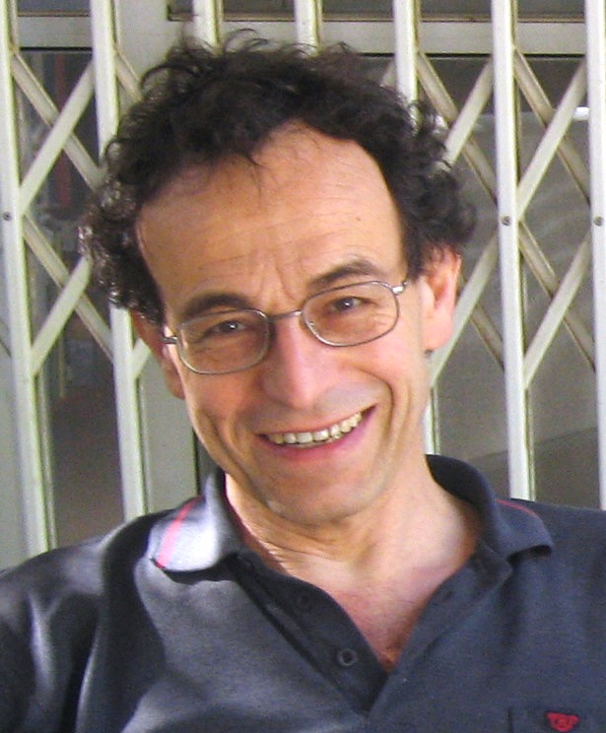

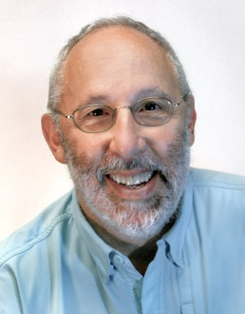



Editors-in-Chief
Editors-in-Chief
David Cahen
Weizmann Inst., Israel
Elizabeth A. Kócs
UI Chicago, USA
David S. Ginley
NREL, USA
Associate Editors
Kristen Brown
ComEd, USA
Sydney Kaufman
State Sen. Begich (AK), USA
Pabitra K. Nayak
Oxford, UK

Slide 3





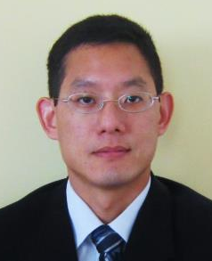

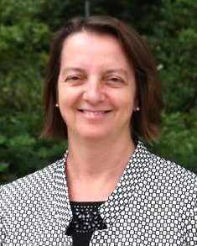

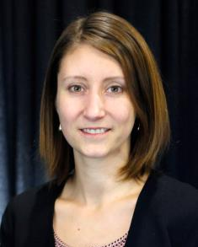
Title
Libby Kupp
POC Chair
Penn State, USA
Ivana Aguiar
Univ. Rep., Uruguay
Jonathan Cullen
Cambridge, UK
Martin Green
NIST, USA
Anthony Ku
NICE, USA/China
Richard A. Souza
MRS Manager,
Edu. & Outreach
Julie Schoenung
UC Irvine, USA
Margeaux Wallace
GE Global Res., USA
Ashley White
Berkeley Lab, USA

Slide 4





Panelists
Discussion Outline
Will economic incentives alone drive deployment of solar and wind electricity, or are policy incentives required?
What materials development is still necessary to better enable renewable technologies?
What education and training of next-generation scientists and engineers is needed?
Ying Shirley Meng
University of California, San Diego
Venkatesh Narayanamurti
Harvard University

Slide 5

www.mrs.org/vote
Network: Spring2018
Password: None Required

Slide 6
Where are you from?
United States
Africa
Asia
Europe
Oceania
Other North or Central America
South America
www.mrs.org/vote

Slide 7

Notes:
LiveSlide
http://www.mrs.org/poll-results

Slide 8

What type of institution do you represent?
    University
    Industry
    Government-sponsored lab
    Government agency
    Other
www.mrs.org/vote

Slide 9
Notes:
LiveSlide
http://www.mrs.org/poll-results

Slide 10
What is your career stage?
        Student
        Postdoc
        Early career
        Mid career
        Late career
www.mrs.org/vote

Slide 11
Notes:
LiveSlide
http://www.mrs.org/poll-results

Slide 12
Why are you at this session?
      I think this topic is interesting
      This topic relates to my research
      I don’t know much about the topic and want to learn more about it
      Another reason
www.mrs.org/vote

Slide 13
Notes:
LiveSlide
http://www.mrs.org/poll-results

Slide 14
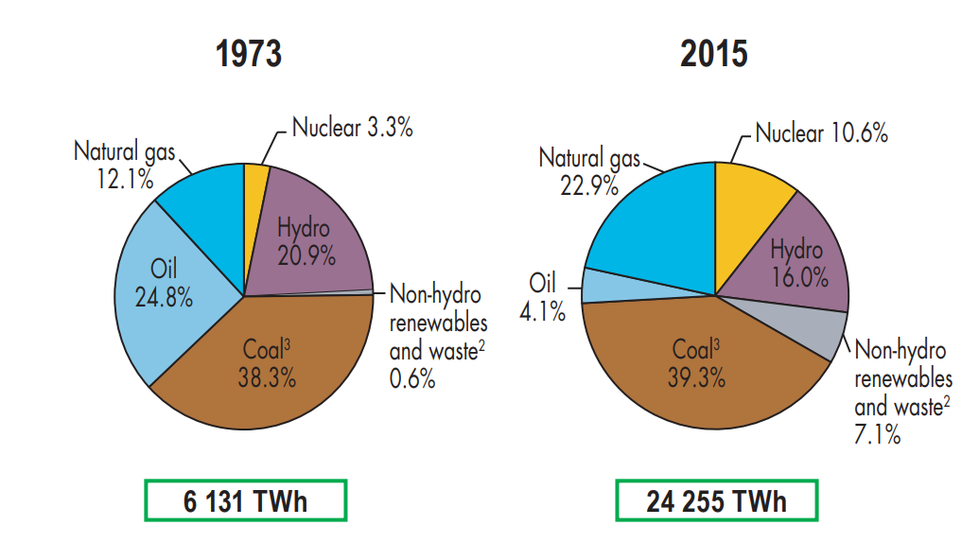
What does our energy supply look like now?
Electricity supply: US vs Worldwide
Counter point include transportation
Electricity Generation
6,131 TWh
24,255 TWh
Source: http://www.iea.org/publications/freepublications/publication/KeyWorld2017.pdf

Slide 15
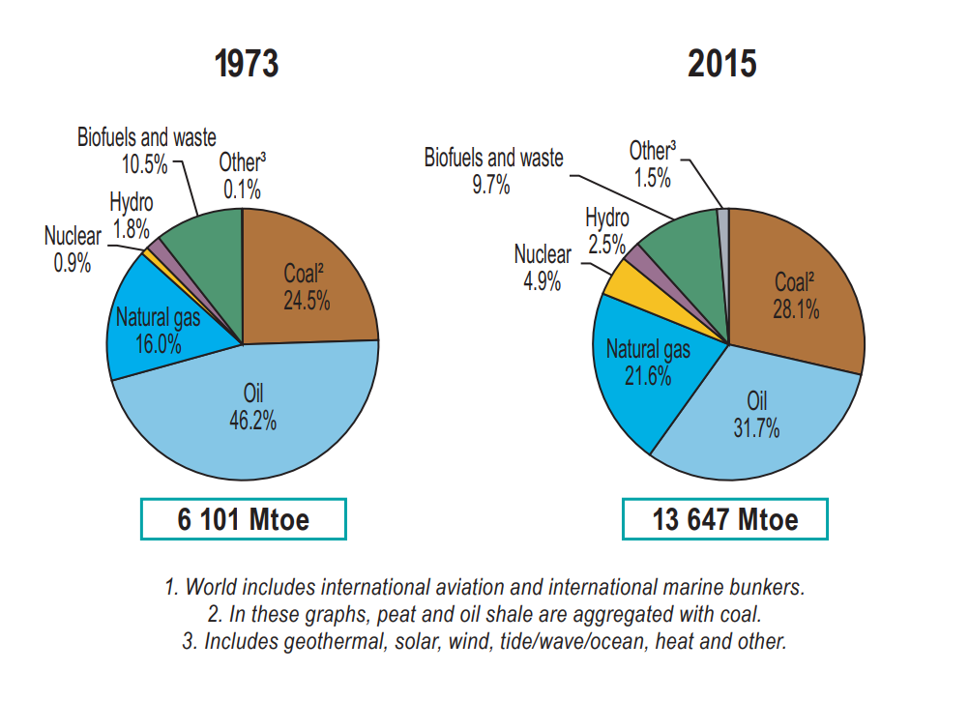
What does our energy supply look like now?
Electricity Generation
Total Energy Usage
24,255 TWh
158, 714 TWh
Source: http://www.iea.org/publications/freepublications/publication/KeyWorld2017.pdf

Slide 16
What is the projected world use of fossil fuels in 2040?
            33%
            77%
            85%
            92%
www.mrs.org/vote

Slide 17
Notes:
LiveSlide
http://www.mrs.org/poll-results

Slide 18
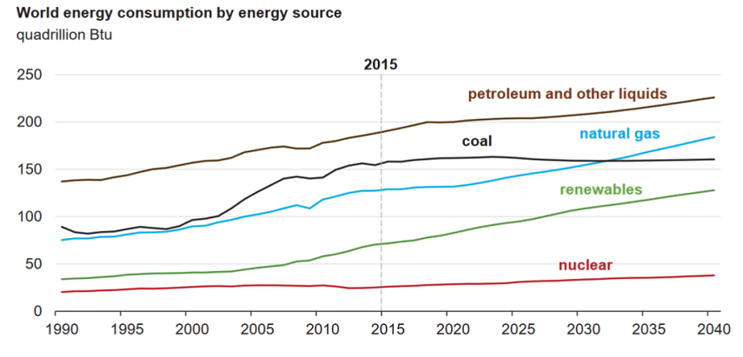
What is the projected world use of fossil fuels in 2040?
2015 Use: 581 quads = 158,700 TWh
Source: https://www.eia.gov/outlooks/ieo/exec_summ.php

Slide 19
Panelists
Discussion Outline
Will economic incentives alone drive deployment of solar and wind electricity, or are policy incentives required?
What materials development is still necessary to better enable renewable technologies?
What education and training of next generation scientists and engineers is needed?
Ying Shirley Meng
University of California, San Diego
Venkatesh Narayanamurti
Harvard University
www.mrs.org/vote

Slide 20
Priority Research Directions in Electrochemical Energy Storage

Slide 21
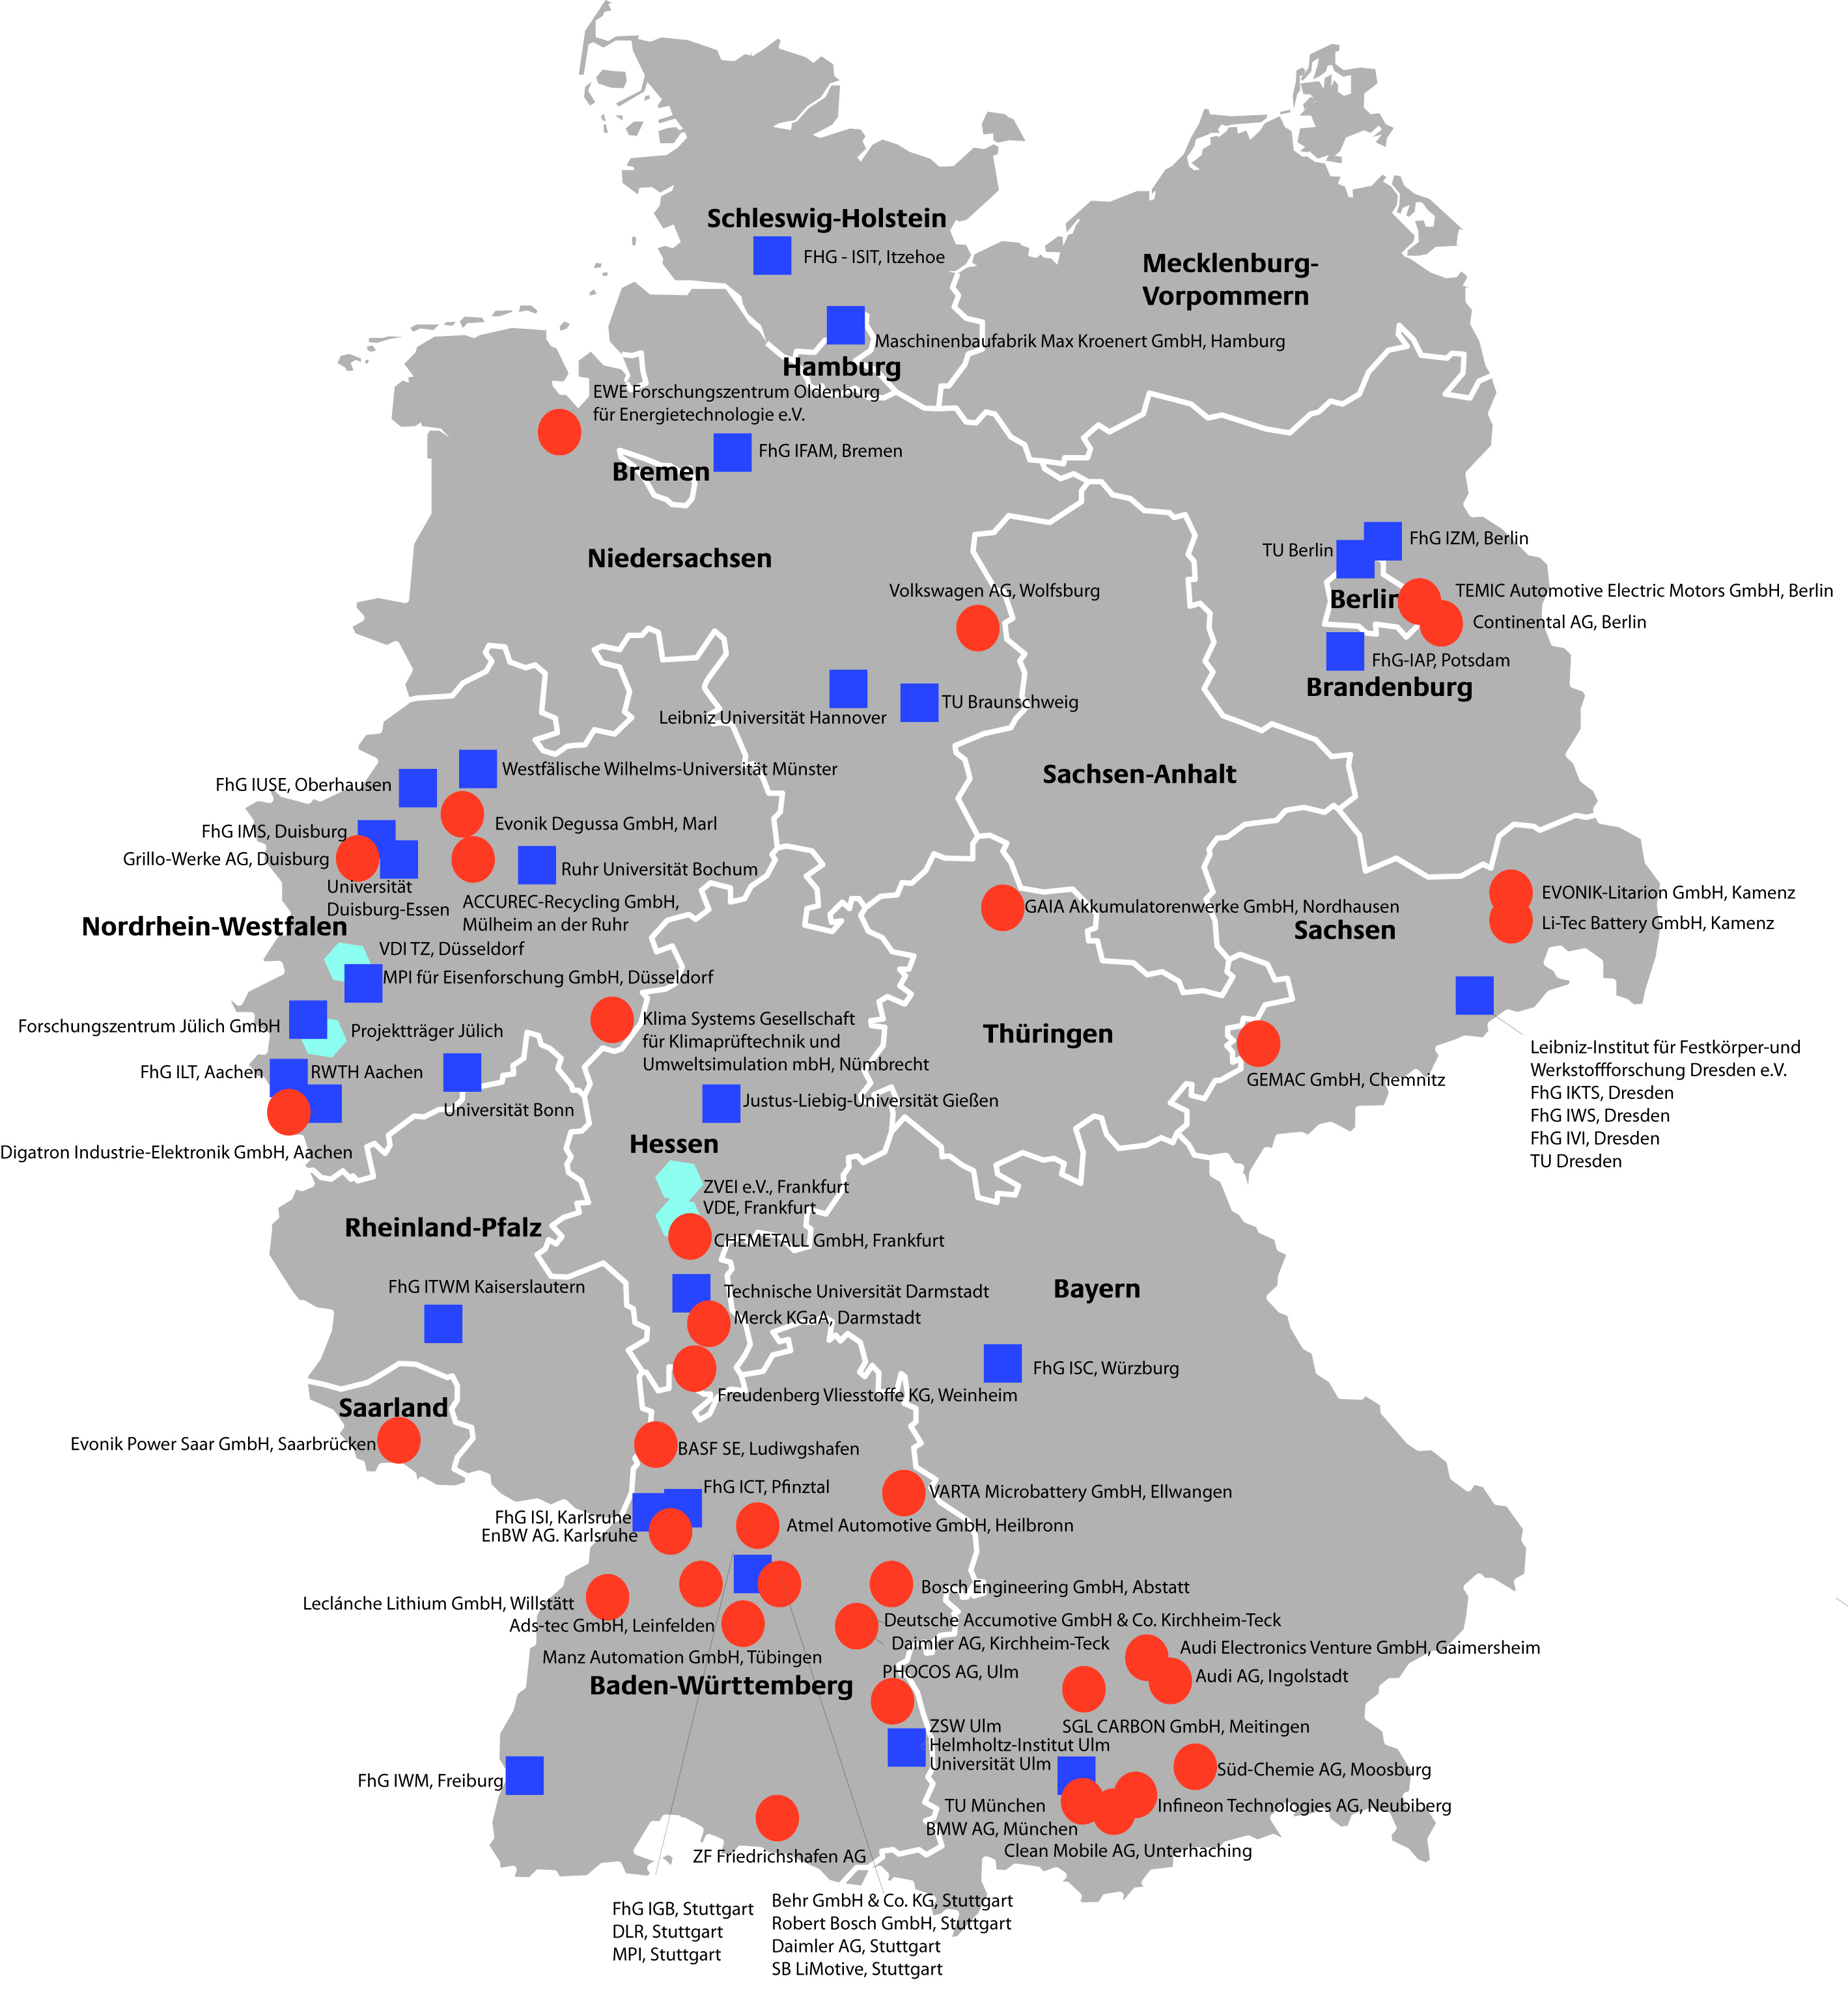
Cooperation:
To Create Added Value, Not as Added Value
Cooperation along supply/knowledge chain
Raw Materials
Com- ponents
Cell
Battery
Power
Train
Electro-
mobility
German Landscape of
Research for Energy Storage
■ Academia
• Industry
■ Project
management
Lab
Pilot
Series
Cooperation along technology maturity chain
Idea
Prototype
Application
Academia, industry, government: Communication, interaction and cooperation
Taking role in specific chain steps; Role depends on maturity stage
Cooperation along the supply chain, not only with neighboring chain segments
Comparison of competing technologies: Same maturity stage, same application
4 Excellent Battery Clusters.
Many “Scientific Hot Spots”

Slide 22
The need to break the Basic–Applied Dichotomy
The necessity for policies to support the entire innovation chain across valleys of death
Materials Science must be closely coupled with device physics and engineering in order to attain its full potential

Slide 23
Will economic incentives alone drive deployment of solar and wind electricity, or are policy incentives required?
Economic incentives alone will work
Policy will play the dominant role
Economics and policy will both play important roles
www.mrs.org/vote

Slide 24
Notes:
LiveSlide
http://www.mrs.org/poll-results

Slide 25
Do tariffs, like those imposed on solar panels by the Trump Administration, work to support greater penetration of renewables?
Always
Depends
Never
Don’t know
www.mrs.org/vote

Slide 26
Notes:
LiveSlide
http://www.mrs.org/poll-results

Slide 27
What type of organization will play the largest role in developing the materials technologies for renewable energy?
Universities
Industry
Government-funded labs
Partnerships involving all three
www.mrs.org/vote

Slide 28
Notes:
LiveSlide
http://www.mrs.org/poll-results

Slide 29
What education and training will best enable next-generation scientists to create and deploy renewable technologies?
Current university curricula do a good job
More industry internships/coops are needed
More training in economics and policy is needed
More cross-training in other scientific disciplines is needed
www.mrs.org/vote

Slide 30
Notes:
LiveSlide
http://www.mrs.org/poll-results

Slide 31
Which sustainable technology do you believe will have the greatest impact by 2050?
Solar
Wind
Nuclear power
Geothermal
Hydrothermal
Biomass
Other
www.mrs.org/vote

Slide 32
Notes:
LiveSlide
http://www.mrs.org/poll-results

Slide 33
How would you describe this panel session?
      Great, I learned a lot
      Inspiring
      Interesting
      Somewhat useful
      Not useful
www.mrs.org/vote

Slide 34
Notes:
LiveSlide
http://www.mrs.org/poll-results

Slide 35



Thank you for
your participation!

Slide 36


2

Slide 37


Slide 38
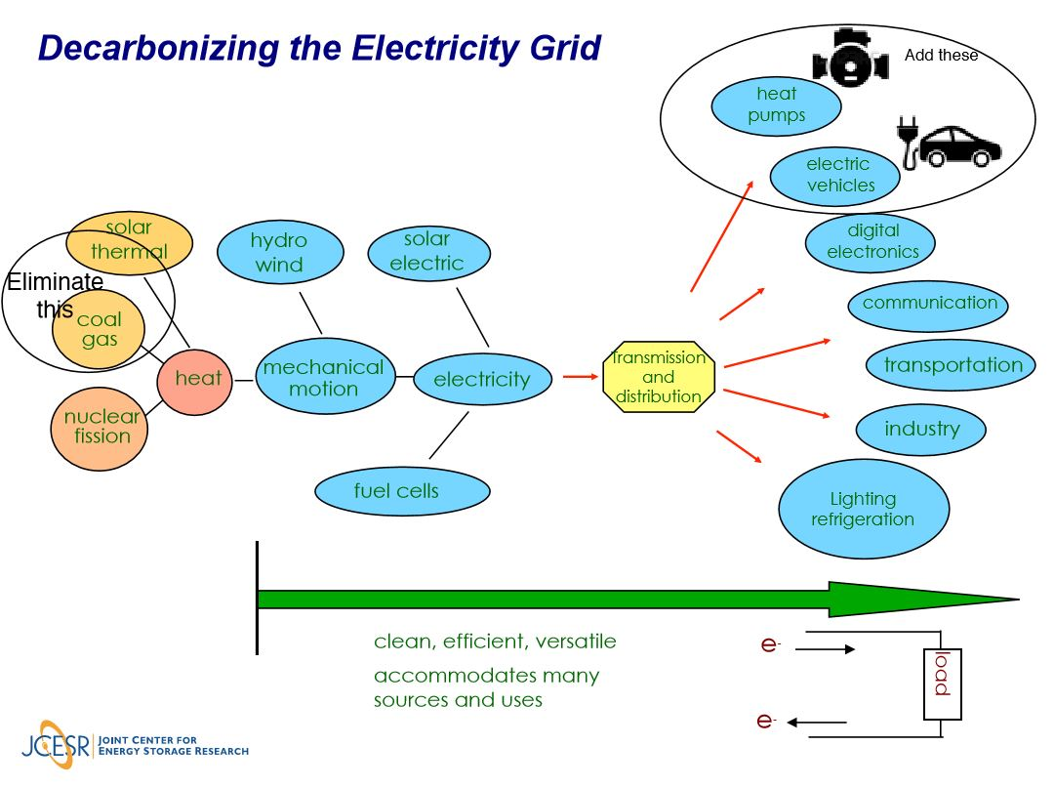

Slide 39
Cooperation:
To Create Added Value, Not as Added Value
German Landscape of
Research for Energy Storage
Cooperation along supply/knowledge chain
Raw Materials
Com- ponents
Cell
Battery
Power
Train
Electro-
mobility
Lab
Pilot
Series
Cooperation along technology maturity chain
Idea
Prototype
Application
Taking role in specific chain steps, activity depends on maturity stage
Cooperation along the value chain, not only with neighboring chain segments
Communication, interaction and cooperation: Academia, industry, government
Comparison of competing technologies: Same maturity stage, same application
Combining continuity and creativity: Targets, funding, staff
4 Excellent Battery Clusters.
Many “Scientific Hot Spots”

Slide 40
- The need to break the Basic–Applied Dichotomy
- The necessity for policies to support the entire innovation chain across valleys of death
- Materials Science must be closely coupled with device physics and engineering in order to attain its full potential
April 2018
IISc.,Bangalore

Slide 41
Priority Research Directions in Electrochemical Energy Storage

Slide 43
Priority Research Directions in Electrochemical Energy Storage

