Slide 1
Precious metals and coinagE
Florin Curta
Department of History
IMOS
Intended for classroom instruction only.
Do not circulate.

Slide 2
Ancient Greek electrum coin
Kyzikos in Mysia (Asia Minor)
550-475 B.C.
IMOS
Intended for classroom instruction only.
Do not circulate.

Slide 3
Indian silver-punched coin (karshapana)
Magadha
4th century B.C.
IMOS
Intended for classroom instruction only.
Do not circulate.

Slide 4
Chinese bronze, spade-shaped coin (bu)
Anyang
340-250 B.C.
IMOS
Intended for classroom instruction only.
Do not circulate.

Slide 5
What is money?
money=anything that serves as a medium of exchange and a store of wealth
currency=a form of money, the value of which is guaranteed within a given territory at a given time (e.g., the dollar is the US currency)
coin(s)=a form of money, but also a form of currency
IMOS
Intended for classroom instruction only.
Do not circulate.

Slide 6
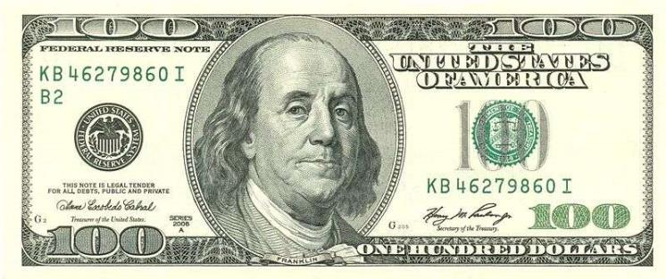
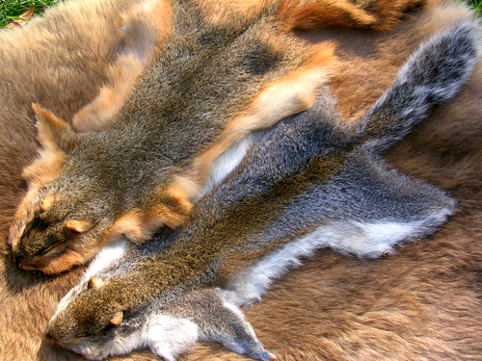
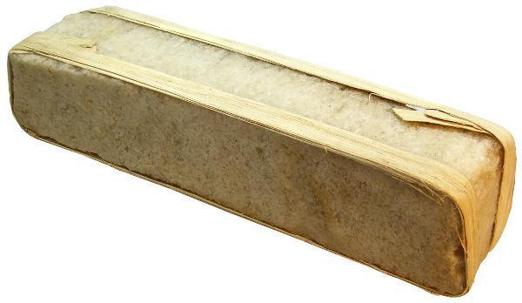
Forms of money
IMOS
Intended for classroom instruction only.
Do not circulate.

Slide 7
How was money invented?
IMOS
Intended for classroom instruction only.
Do not circulate.
“When the inhabitants of one country became more dependent on those of another, and they imported what they needed, and exported what they had too much of, money necessarily came into use. For the various necessaries of life are not easily carried about, and hence men agreed to employ in their dealings with each other something which was intrinsically useful and easily applicable to the purposes of life, for example, iron, silver, and the like. Of this the value was at first measured simply by size and weight, but in process of time they put a stamp upon it, to save the trouble of weighing and to mark the value.” (Aristotle, Politics I 9.7-8)
“The builder, then, must get from the shoemaker the latter's work, and must himself give him in return his own. If, then, first there is proportionate equality of goods, and then reciprocal action takes place, the result we mention will be effected. If not, the bargain is not equal, and does not hold; for there is nothing to prevent the work of the one being better than that of the other; they must therefore be equated. (…) This is why all things that are exchanged must be somehow comparable. It is for this end that money has been introduced, and it becomes in a sense an intermediate; for it measures all things, and therefore the excess and the defect-how many shoes are equal to a house or to a given amount of food. The number of shoes exchanged for a house (or for a given amount of food) must therefore correspond to the ratio of builder to shoemaker.” (Aristotle, Nicomachean Ethics V 5.8-10)

Slide 8
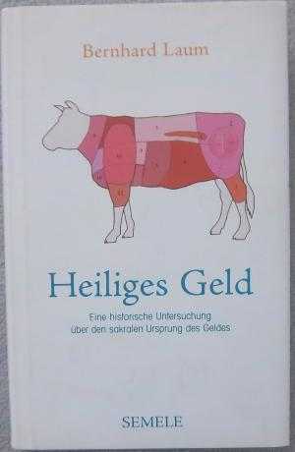
Bernhard Laum (1884-1974)
The author of Sacred Money (1924)
IMOS
Intended for classroom instruction only.
Do not circulate.

Slide 9
“Sacred money”: sacrificial utensils
IMOS
Intended for classroom instruction only.
Do not circulate.
Cauldron
Tripod

Slide 10
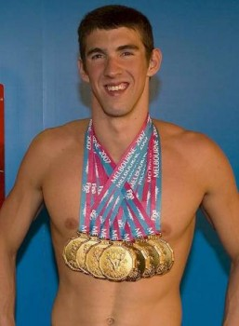
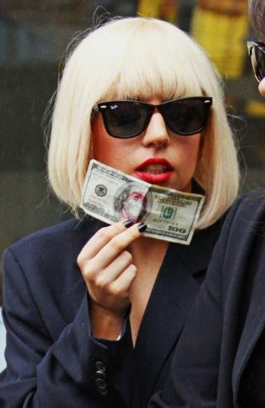
What is the role of money?
Medium of exchange: without it, no complex economy
Standard of value: without it, goods cannot be compared to each other
Way of storing value
IMOS
Intended for classroom instruction only.
Do not circulate.

Slide 11
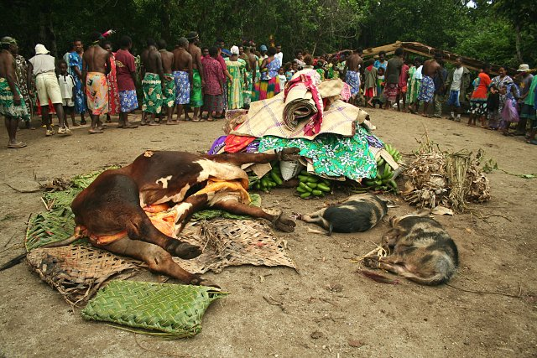
Money as a means of payment
Bride price in Vanuatu

Slide 12
Silver as standard of value in ancient Egypt: Erenofre buys a slave girl
“1 shroud of Upper Egyptian cloth, makes 5 kite of silver;
1 blanket of Upper Egyptian cloth, makes 3 1/3 kite of silver;
1 djayt garment of Upper Egyptian cloth, makes 4 kite of silver;
3 sdy-garments of fine Upper Egyptian cloth, makes 5 kite of silver;
1 dress of fine Upper Egyptian cloth, makes 5 kite of silver…”
(court deposition document from the reign of Ramses II, 1279-1213 B.C.)

Slide 13
First commercial use of precious metals
Cuneiform tablet from the Kültepe archive (19th c. B.C.)

Slide 14
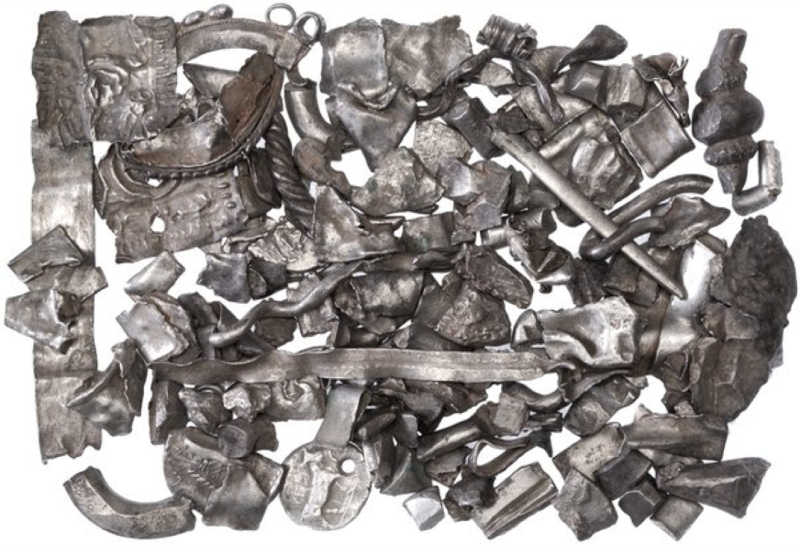
Precious metals as money: hacksilver
IMOS
Intended for classroom instruction only.
Do not circulate.

Slide 15
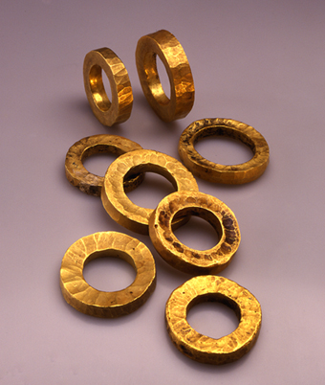
Wealth in the Old Testament
Now he [the Pharaoh] treated Abram well for her [Sarai’s] sake, and gave him sheep, oxen, donkeys, male and female servants, mules, and camels (Genesis 12:16)
Abram was very rich in cattle, silver, and gold (Genesis 13:2)
Isaac “began to prosper, and continued prospering until he became very prosperous; for he had herds of sheep and oxen and many fields.” (Genesis 26:13-14)
IMOS
Intended for classroom instruction only.
Do not circulate.

Slide 16
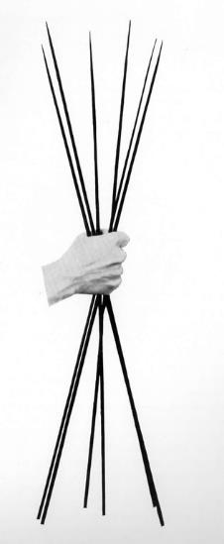
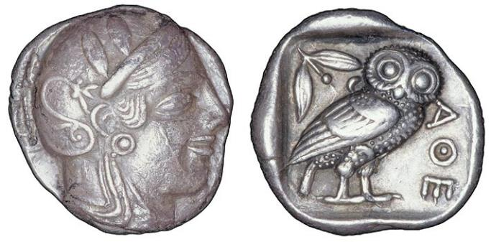
Drachma=a handful of (six) spits
IMOS
Intended for classroom instruction only.
Do not circulate.

Slide 17
Chinese knife money (huo)
State of Qi, 4th century B.C.
IMOS
Intended for classroom instruction only.
Do not circulate.

Slide 18
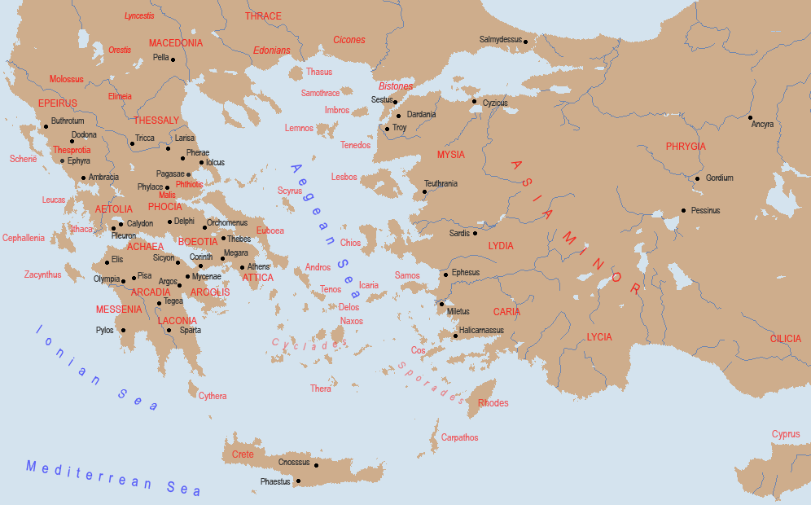
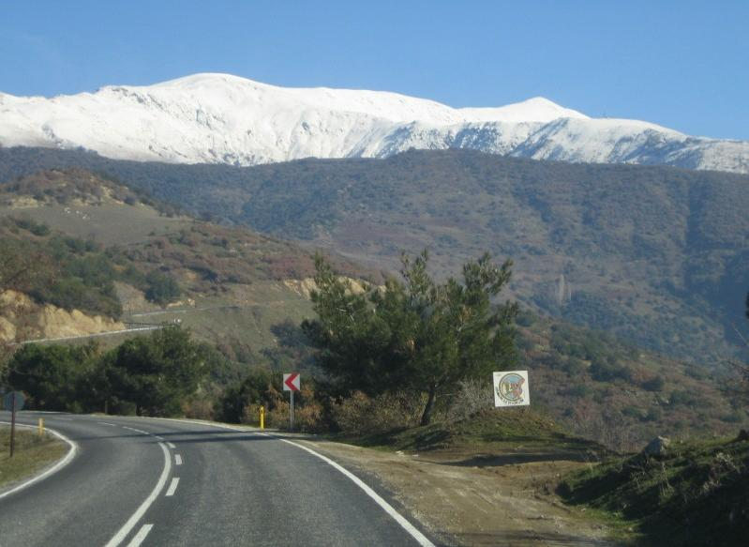
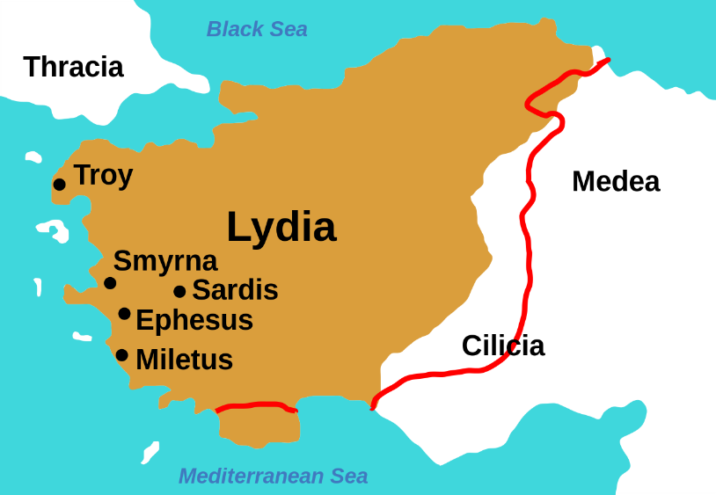
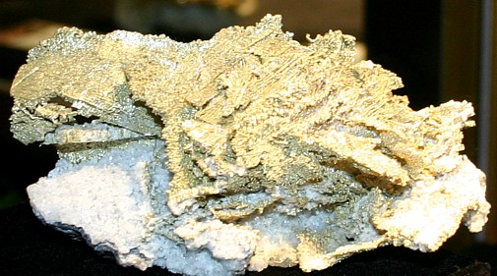
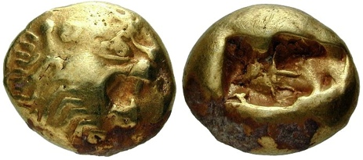
The earliest datable coins: electrum coins from Ephesus
IMOS
Intended for classroom instruction only.
Do not circulate.

Slide 19
Silver coinage in ancient Greece
IMOS
Intended for classroom instruction only.
Do not circulate.
Aegina, “turtle” stater, 480 B.C.
Athens, “owl” didrachm, 450-440 B.C.

Slide 20
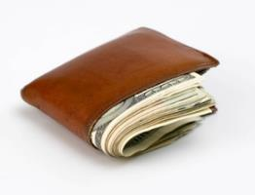
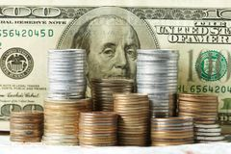
Six characteristics of money
Durability: cannot ruin easily
Divisibility: must be easy to divide into smaller denominations
Portability: must be easy to move around
Homogeneity: each unit should be the same as all others
Acceptability: people need to recognize it for daily use
Of limited or stable supply: deferred consumption
IMOS
Intended for classroom instruction only.
Do not circulate.

Slide 21
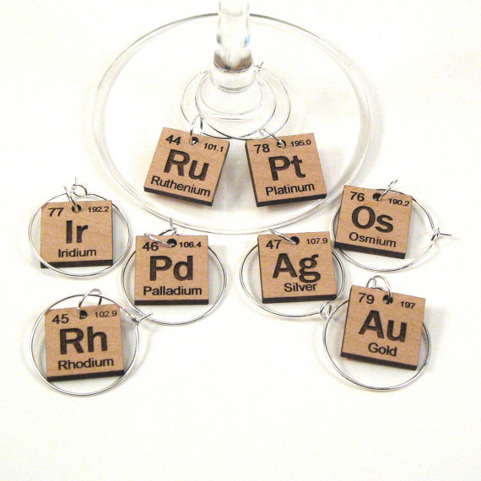
Coinage metal criteria
IMOS
Intended for classroom instruction only.
Do not circulate.

Slide 22
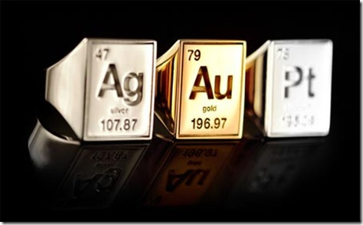
Gold and silver as coinage metals
French for “money” is argent (derived from Latin argentum=silver)
German for money is Geld, a cognate of Gold
Russian for money is деньги (derived from the Turkic word tenge=silver coin)
IMOS
Intended for classroom instruction only.
Do not circulate.

