Slide 1
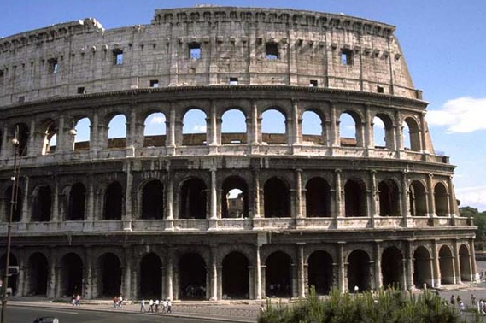
Engineering Society through Social Spaces
Roman Concrete- Mary Ann Eaverly,Classics
IMOS
Intended for classroom instruction only.
Do not circulate.

Slide 2
The impact of materials varies depending upon the socio-cultural context.
IMOS
Intended for classroom instruction only.
Do not circulate.

Slide 3
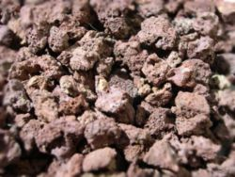
pozzolana
IMOS
Intended for classroom instruction only.
Do not circulate.

Slide 4
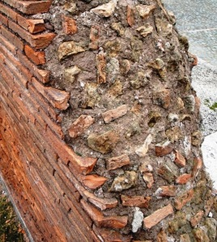
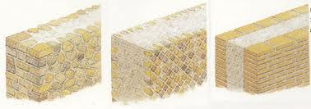
Opus caementicum
IMOS
Intended for classroom instruction only.
Do not circulate.

Slide 5
IMOS
Intended for classroom instruction only.
Do not circulate.

Slide 6
Pantheon Rome, 2nd c. AD
IMOS
Intended for classroom instruction only.
Do not circulate.

Slide 7
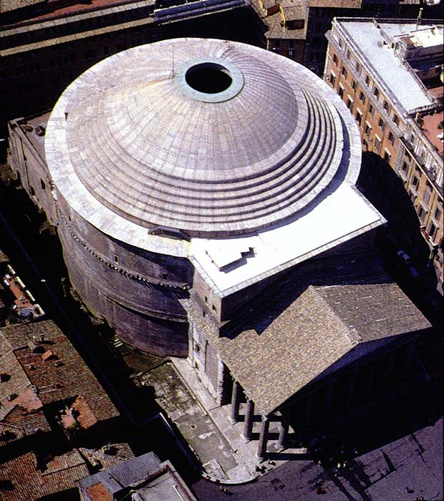
IMOS
Intended for classroom instruction only.
Do not circulate.

Slide 8
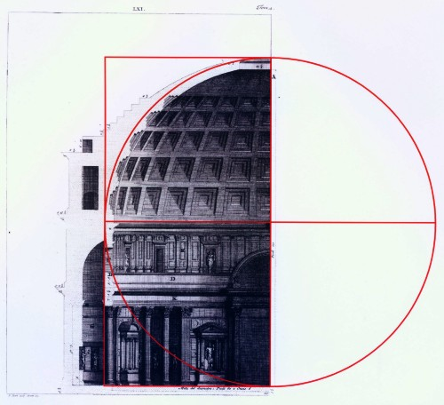
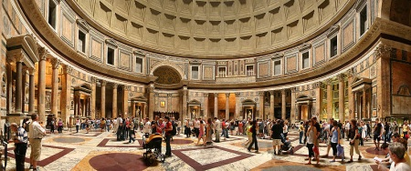
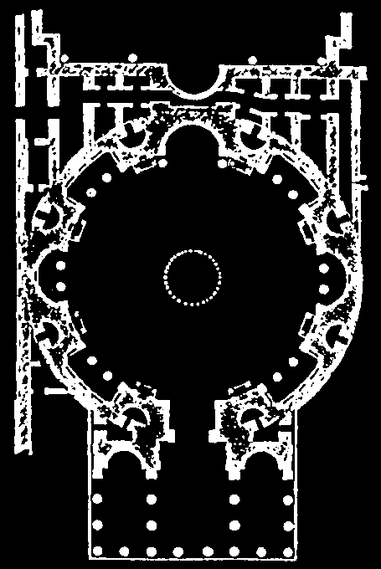
Roman Concrete Revolution—interior space
IMOS
Intended for classroom instruction only.
Do not circulate.

Slide 9
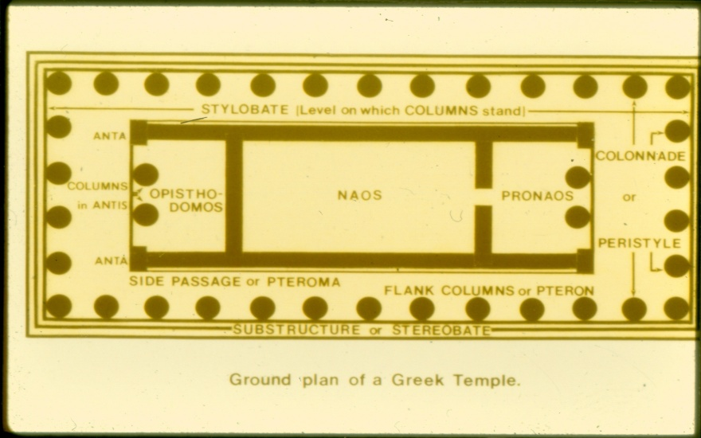
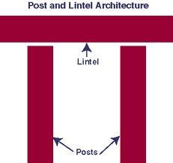
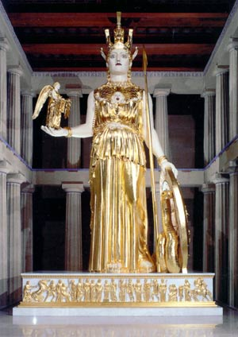
Parthenon, Athens, 5th c .BC
IMOS
Intended for classroom instruction only.
Do not circulate.

Slide 10
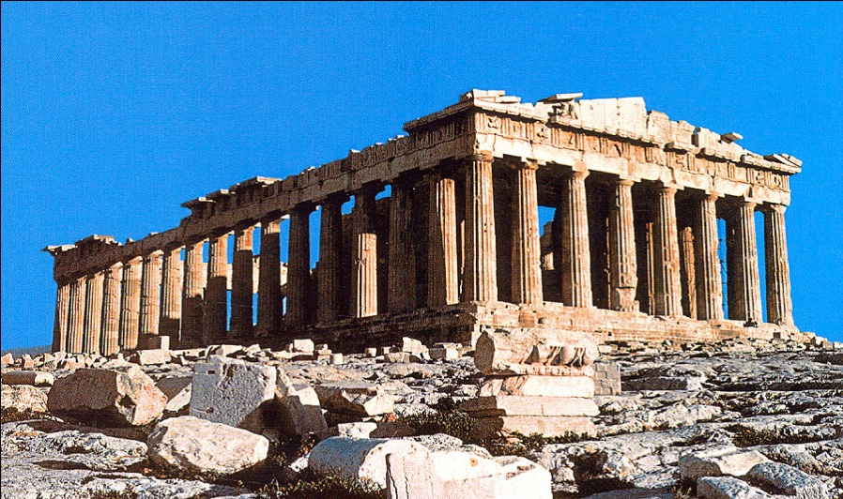
Pantheon Rome, 2nd c. AD
IMOS
Intended for classroom instruction only.
Do not circulate.

Slide 11
Colosseum (Flavian Amphitheater) Rome, First c. AD
IMOS
Intended for classroom instruction only.
Do not circulate.

Slide 12
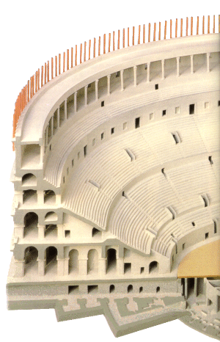
IMOS
Intended for classroom instruction only.
Do not circulate.

Slide 13
Amphitheater
IMOS
Intended for classroom instruction only.
Do not circulate.

Slide 14
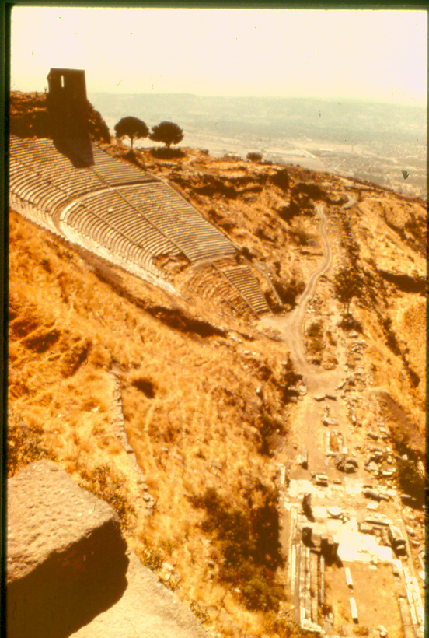
Greek Theater at Pergamon
IMOS
Intended for classroom instruction only.
Do not circulate.

Slide 15
Doric, Ionic, Corinthian columns
IMOS
Intended for classroom instruction only.
Do not circulate.

Slide 16
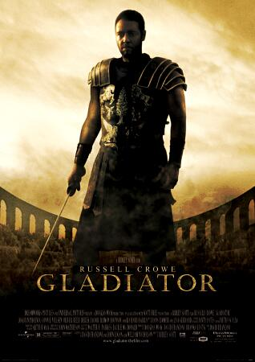
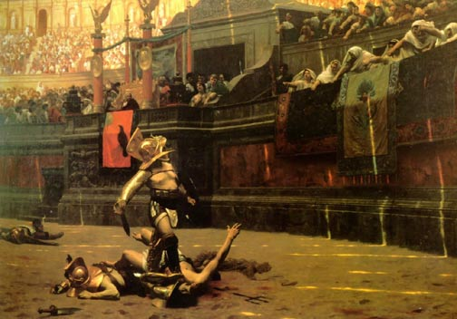
Gladiatorial games
IMOS
Intended for classroom instruction only.
Do not circulate.

Slide 17
IMOS
Intended for classroom instruction only.
Do not circulate.

Slide 18
Substructures
IMOS
Intended for classroom instruction only.
Do not circulate.

Slide 19
Class Structure
FREEBORN or NON-FREEBORN
Freeborn= Patricians (upper-Class) and Plebeians (regular people)
Non-Freeborn= Slaves and Freedpersons
IMOS
Intended for classroom instruction only.
Do not circulate.

Slide 20
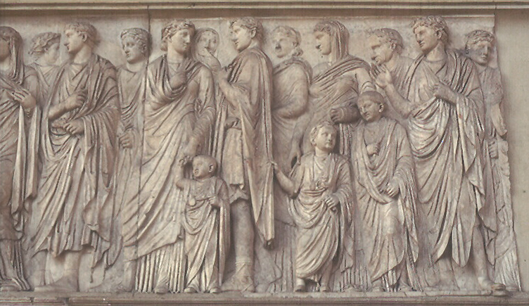
IMOS
Intended for classroom instruction only.
Do not circulate.

Slide 21
Reinforcing social order
IMOS
Intended for classroom instruction only.
Do not circulate.

Slide 22
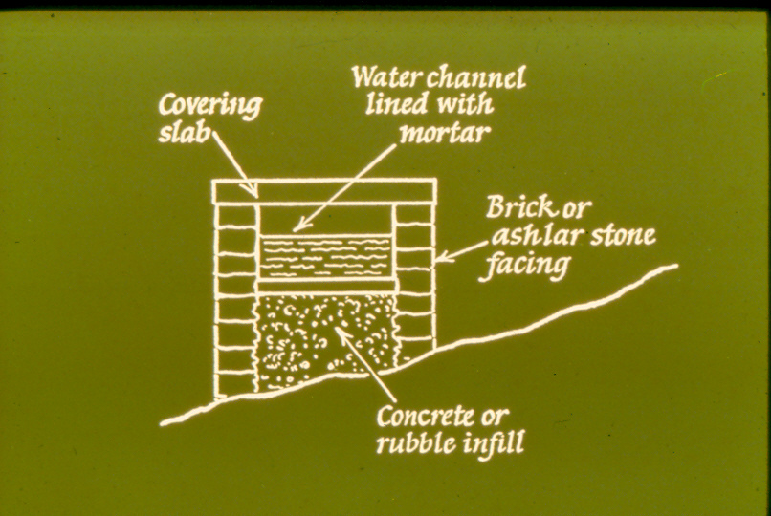
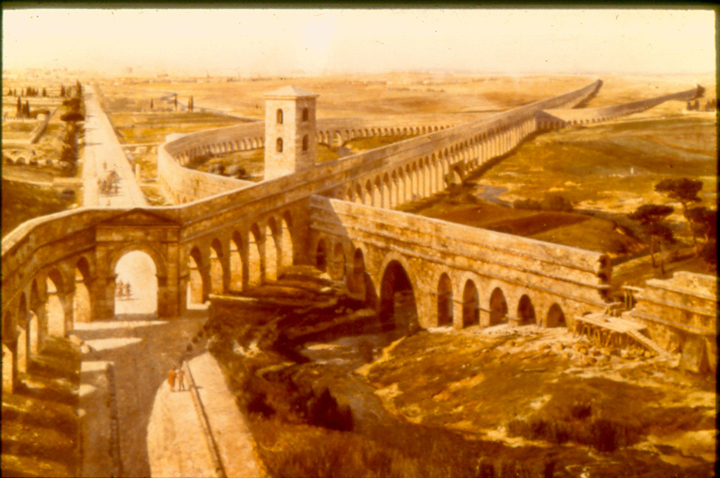
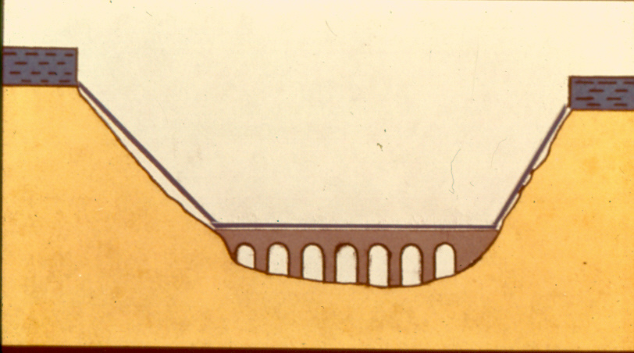
Water for Concrete—Aqueducts
IMOS
Intended for classroom instruction only.
Do not circulate.

Slide 23
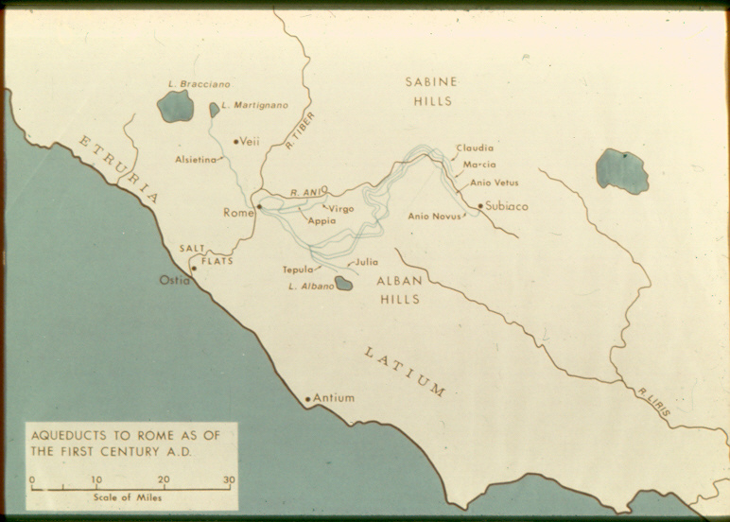
IMOS
Intended for classroom instruction only.
Do not circulate.

Slide 24
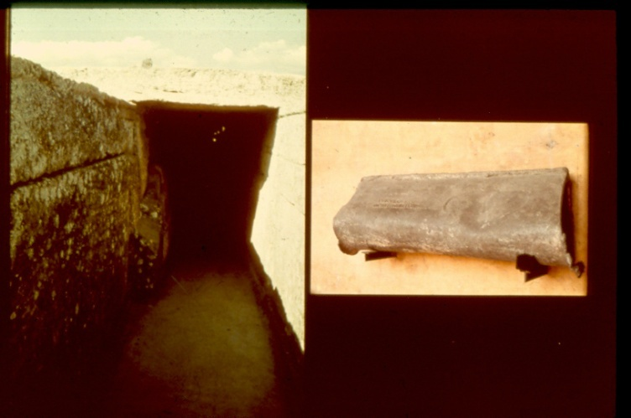
Pipes
IMOS
Intended for classroom instruction only.
Do not circulate.

Slide 25
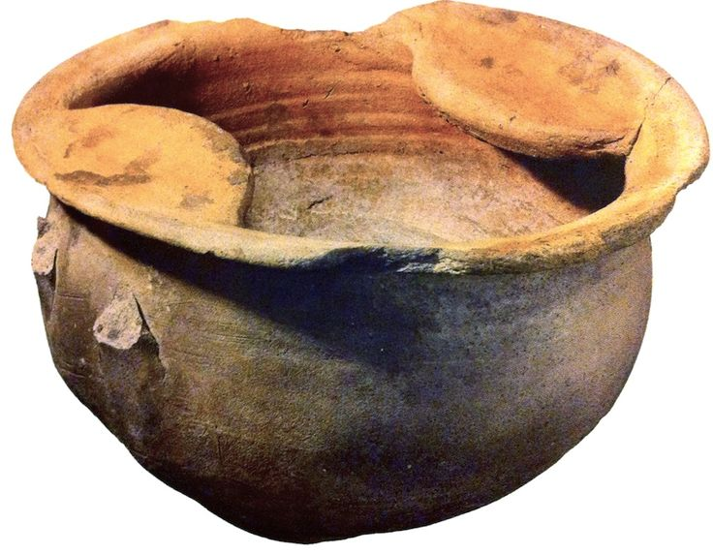
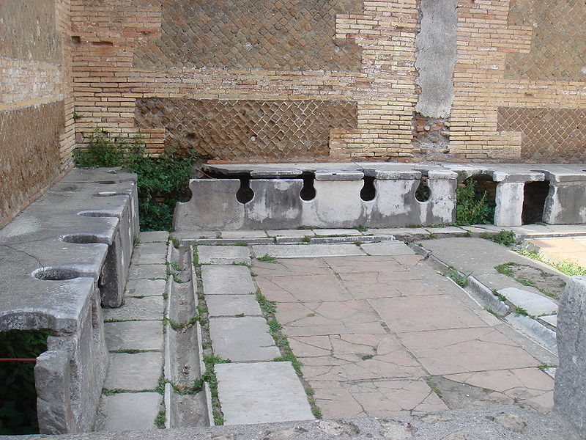
Bathrooms
IMOS
Intended for classroom instruction only.
Do not circulate.

Slide 26
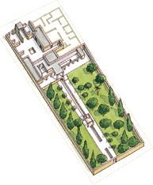
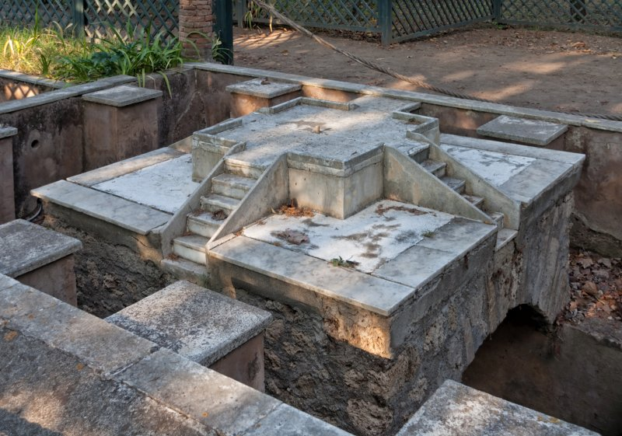
House of Octavius Quartio, Pompeii, 1st c. AD
IMOS
Intended for classroom instruction only.
Do not circulate.

Slide 27
Tombstone of freedman Tiberius Claudius Secundus, Rome 1st AD
‘Wine, sex and baths ruin our bodies, but they are the stuff of life.’
IMOS
Intended for classroom instruction only.
Do not circulate.

Slide 28
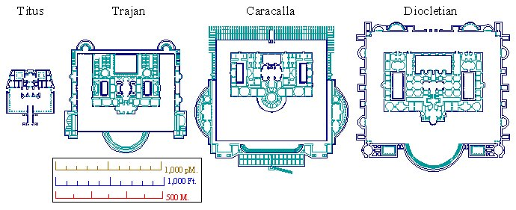
Baths in Rome 1st c. AD- 3rd^{th} c. AD
IMOS
Intended for classroom instruction only.
Do not circulate.

Slide 29
Baths
IMOS
Intended for classroom instruction only.
Do not circulate.

Slide 30
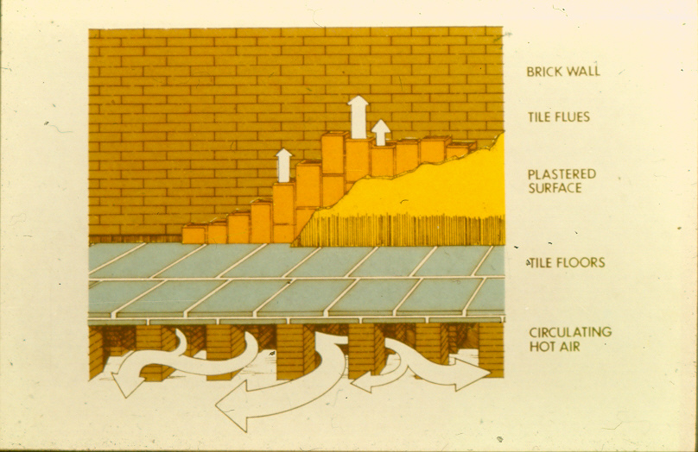
Hypocaust system(Sergius Orata)
IMOS
Intended for classroom instruction only.
Do not circulate.

Slide 31
Sergius gets an idea
IMOS
Intended for classroom instruction only.
Do not circulate.

Slide 32
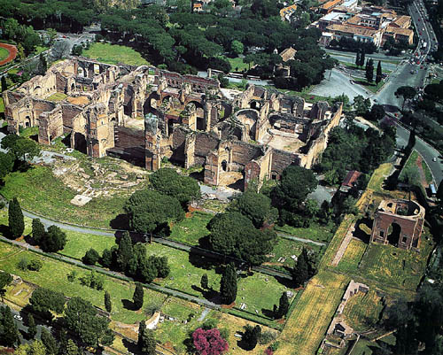
Baths of Caracalla, Rome, 2nd c .AD
IMOS
Intended for classroom instruction only.
Do not circulate.

Slide 33
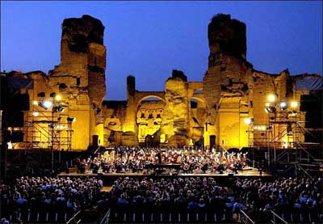
IMOS
Intended for classroom instruction only.
Do not circulate.

Slide 34
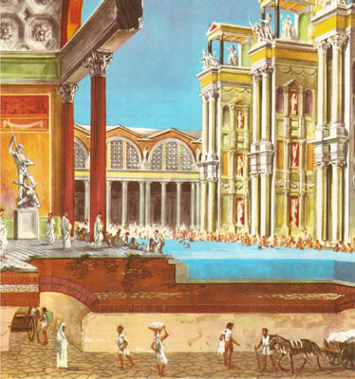
IMOS
Intended for classroom instruction only.
Do not circulate.

Slide 35
Baths of Diocletian ( Santa Maria degli Angeli) 3rd c. AD Rome
IMOS
Intended for classroom instruction only.
Do not circulate.

Slide 36
Soldier Field, Chicago
IMOS
Intended for classroom instruction only.
Do not circulate.

