Slide 1
TOPICS FOR THE FIRST EXAM
Clay
Ceramics and Glass
Copper and Bronze
Concrete
Gold and Silver

Slide 2
Clay
Properties
Structure
Chemistry
Kaolinite vs Montmorrillonite
Why is it ductile
Source
Primary vs secondary
History
Japan to modern times
Ancient applications
Buildings, sickle, cuneiform, ocarina
Modern Uses
Shrink- swell ratio
Dams, oil drilling etc.
Entanglement
Catal Hoyuk
Humans depend on things etc.
Tanglegrams
Challenges of entanglement
Rare Earths
Definition
Critical Materials
Sourcing challenge
Applications
Electric vehicles
Wind farms
Lighting

Slide 3
Ceramics and Glass
Properties
Amorphous vs Crystalline
Glass vs Ceramic
History
Faience
Natron
Network modifiers network formers
Soda lime glass
Core wound, blowing
Structure/properties
Tension vs compression
Rupert Drop
Modern applications
Float glass
Fiber optics
Gorilla Glass, Pyrex
Operational Chain
Relationship to entanglement
Obsidian
Knapping
Spear points
Modern Ceramics
Transducers
Piezoelectrics
Ferrofluids
Functionalization

Slide 4
Copper and Bronze
Properties
Chemistry/Fabrication
Smelting/Alloying
Sn and As
Yield Strength
Dislocations
Work Hardening, Alloy Hardening
Phase Diagram
Annealing Tempering
History
Bronze age
Technologies enabled by Bronze
Otzi
Natural Copper abundance
Trade
Trade Routes, Trade Centers
Applications
Skilled Craftsman
Oxhide Ingots
Solar Cells
Photovoltaics
Semiconductors
Inorganic/Organic
Trade challenges

Slide 5
Concrete
Properties
Chemistry/structure
Concrete vs cement
Formation from limestone, clinker
Reaction with water
Hydraulic Cement
History
Applications
Portland Cement
Greenhouse gases
Worldwide usage
Concrete in ancient Rome
Coliseum
Baths
Aqueducts
Pantheon
Functions enabled by concrete
Social Structures of Ancient Rome
Modern Concrete
Transducers
Flexible concrete
Green Concrete
CO₂ sequestration

Slide 6
Gold and Silver
Properties
Chemistry
Ag and Au alloys
Fabrication
Cupellation
Amalgamation
Liquation
Parting
History
Meteorites
Gold Rushes
USS Central America
Applications
Coinage
Coloring
Art/Jewelry
Electronics
Value
Coins, Money and Currency
4 major functions of money
Wiergeld
Intrinsic vs extrinsic value
Why Gold and Silver
Nanoparticles
What is meant by Nano
Stain glass
Cancer treatment
Functionalized surface
Diagnosis and treatment
Supply and demand

Slide 7
Short answer
In liquation one adds molten lead to the copper silver gold mixture that has been mined, why?
What is the difference between an affordance and a constraint? Is the difference inherent in a specific material? Is it obvious?
Why was the earliest silver coin struck in Greece (Athens) called drachma? What does that word mean, and what is the significance of that word?
What is intensification and how does it impact operational sequences? What does it mean to say there are hidden costs to intensification?

Slide 8
Multiple choice
How is the value of a material usually increased
Finding additional sources of the material
Developing new applications for the material
Streamlining the extraction process of a material
Reducing the waste products associated with the material
All of the above

Slide 9
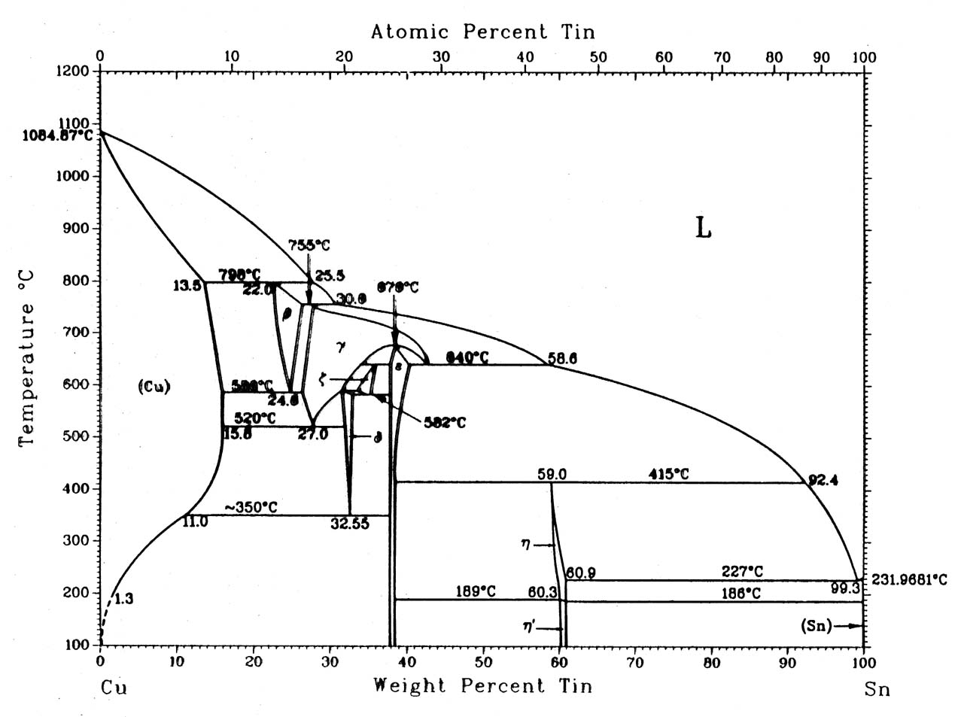
) In the phase diagram below if you make an Bronze alloy of 10 wt% tin
Draw a vertical line on the phase diagram to indicate the 10 wt% tin composition
What is the melting point of this 10 wt% tin Bronze alloy?
In general what happens to the melting point as you add tin to pure copper?

