Slide 1
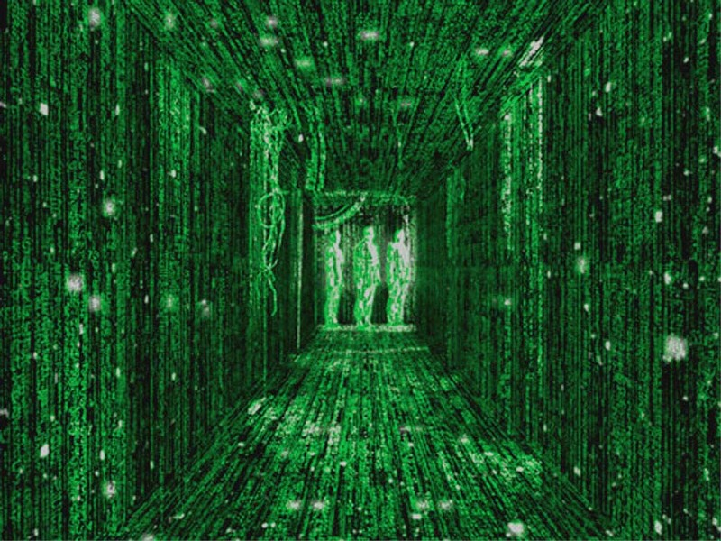
Semiconductors and Cyborgs: Human-Material Relationships in the Digital Age Dr. Sophia Krzys Acord
IMOS
Intended for classroom instruction only.
Do not circulate.
Notes:
Technologic – Daft Punk
Outline of talk
- Intro to sociology
- Information and Industrial Revolutions
Internet of Things
Delegation and its consequences
Conclusion
Homework

Slide 2
What is a cyborg?
IMOS
Intended for classroom instruction only.
Do not circulate.

Slide 3
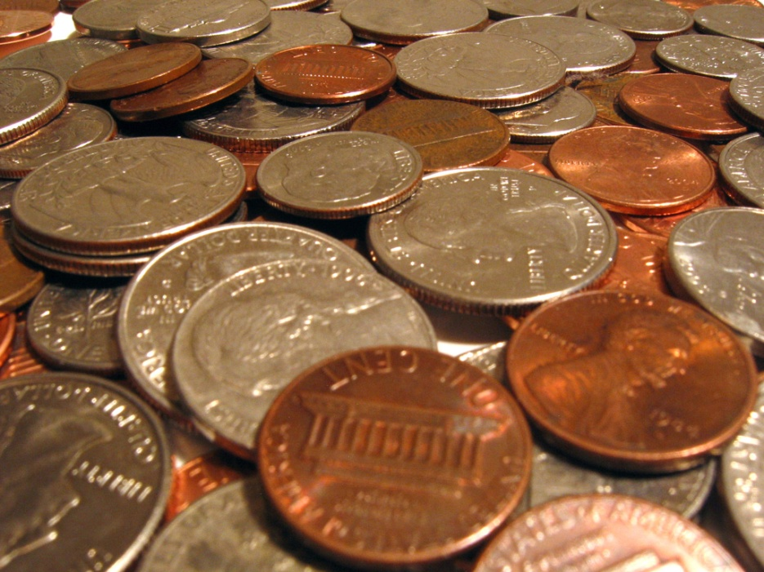
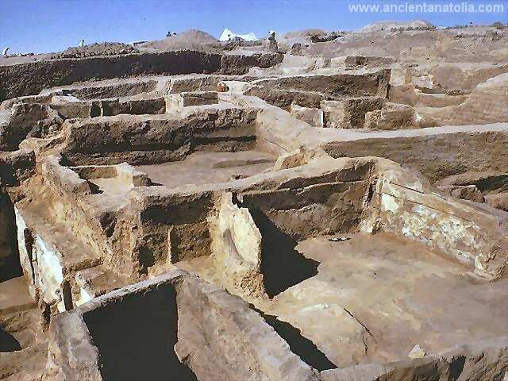
Size matters
IMOS
Intended for classroom instruction only.
Do not circulate.

Slide 4
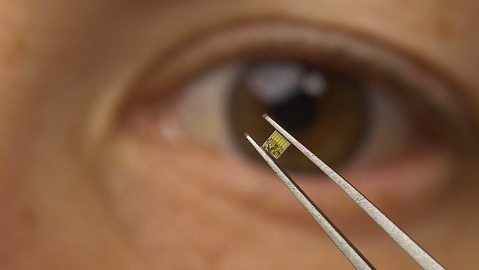
Designed to disappear
IMOS
Intended for classroom instruction only.
Do not circulate.
IBM100 - Silicon Germanium Chips - www-03.ibm.com

Slide 5
1. Writing School of Athens (1510, Raffaelo Sanzio)
IMOS
Intended for classroom instruction only.
Do not circulate.

Slide 6
2. The Printing Press A 16th-century print shop (Philippe Galle, 1537-1612)
IMOS
Intended for classroom instruction only.
Do not circulate.

Slide 7
3. End of 18th century – mass printing (‘Pocket Books’)
IMOS
Intended for classroom instruction only.
Do not circulate.

Slide 8
4. April 1993 – Mosaic Web browser
IMOS
Intended for classroom instruction only.
Do not circulate.

Slide 9
3 Industrial Revolutions: 1780s
IMOS
Intended for classroom instruction only.
Do not circulate.

Slide 10
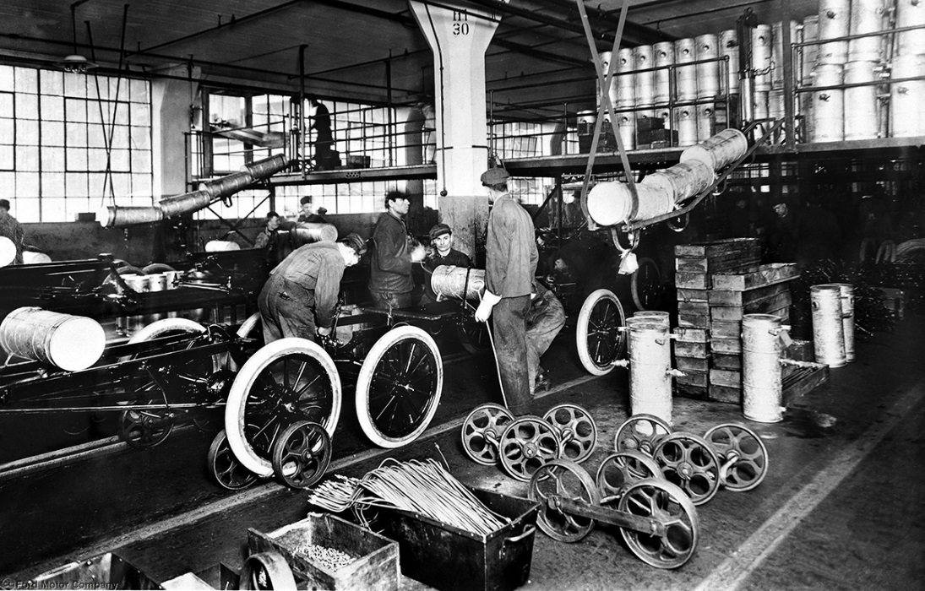
3 Industrial Revolutions: 1780s, 1870s
IMOS
Intended for classroom instruction only.
Do not circulate.

Slide 11
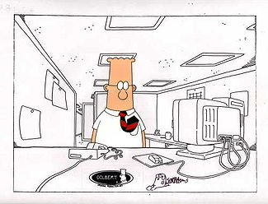
3 Industrial Revolutions: 1780s, 1870s, 1970s
IMOS
Intended for classroom instruction only.
Do not circulate.

Slide 12
The Networked Society
Information as energy source / raw material
Human mind (not body) is a direct productive force
Web 1.0
Web 2.0
Web 3.0
IMOS
Intended for classroom instruction only.
Do not circulate.

Slide 13
IMOS
Intended for classroom instruction only.
Do not circulate.

Slide 14
Which is real?
Pill Pusher
This device tracks how often you open or pick up your pills, then texts you when you don’t. Oh baby!
DigiRazor
Gillette realized a Mach 7 just wasn’t gonna happen. Its newest razor texts you when it’s time to change blades.
IMOS
Intended for classroom instruction only.
Do not circulate.

Slide 15
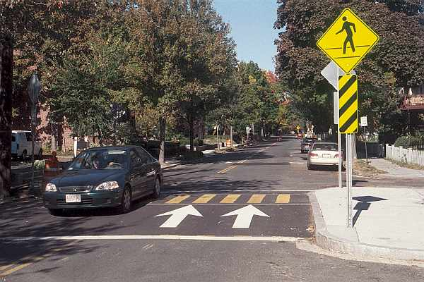
Delegation – A speed bump
IMOS
Intended for classroom instruction only.
Do not circulate.

Slide 16
Delegation – “The Sleeping Policeman”
IMOS
Intended for classroom instruction only.
Do not circulate.

Slide 17
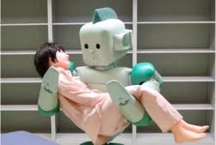
Delegation – Intimate Tasks
IMOS
Intended for classroom instruction only.
Do not circulate.

Slide 18
Delegation – More Intimate Tasks
IMOS
Intended for classroom instruction only.
Do not circulate.

Slide 19
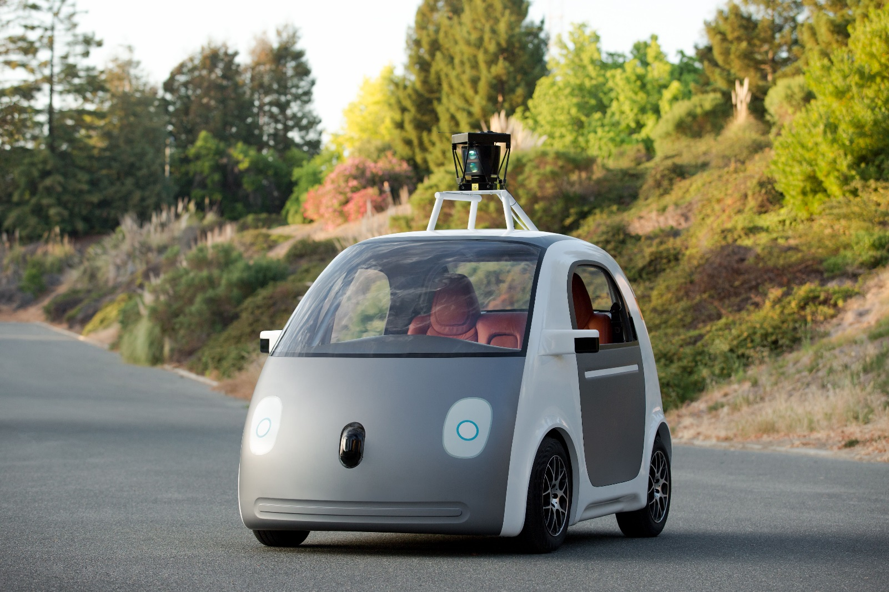
Delegation – Life and Death?
IMOS
Intended for classroom instruction only.
Do not circulate.

Slide 20
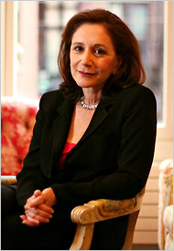
Turkle, Sherry. (2011)
“If there is an addiction here; it is not to a technology. It is to the habits of mind that technology allows us to practice.” (p. 288)
IMOS
Intended for classroom instruction only.
Do not circulate.

Slide 21
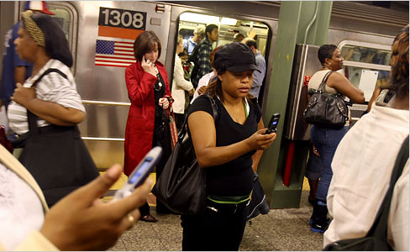
Tethered Selves
IMOS
Intended for classroom instruction only.
Do not circulate.

Slide 22
Permanent Upkeep
IMOS
Intended for classroom instruction only.
Do not circulate.

Slide 23
Cult of the Individual
IMOS
Intended for classroom instruction only.
Do not circulate.

Slide 24
Which Medium Would You Use?
IMOS
Intended for classroom instruction only.
Do not circulate.
Face to Face
Hand-delivered notes
Snail Mail
Email
Phone
Skype w/ webcam
Skype w/out webcam
Text
IM/Gchat/FacebookChat
Snapchat
Facebook message
Facebook wall post or tag
Twitter
(Other)
Rank the top 3 media that you would use for the two following communication goals:
Personal (Volitional)
Personal (Obligational)
Notes:
Mixing of nonchalance and storage

Slide 25
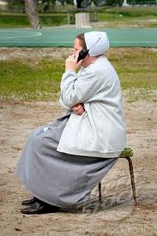
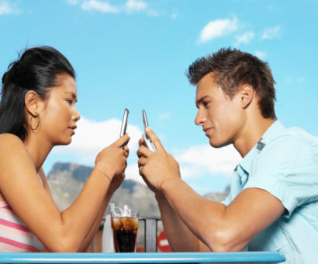
Are We Alone Together?
IMOS
Intended for classroom instruction only.
Do not circulate.
Notes:
Claire Lin, Taiwan Woman, Commits Suicide On Facebook Chat (Huffington Post, Annie Huang, March 27th, 2012)
Hospitals Warn Smartphones Could Distract Doctors (National Public Radio, Jenny Gold, March 26, 2012)
'Put your damn phone down' say social media gurus. Today's texting teenagers learn bad behaviour from their email-obsessed parents 'that it's OK to put people on pause‘ (Guardian UK, Richard Adams, July 1, 2011)
Loneliness vs. Solitude
Friending vs. Friendship
Convenience and Control vs. Empathy
+ Ethical issues like (1) Permission to be forgotten, and (2) Data obscurity (http://iknowwhereyourcatlives.com/about/)
(at the end of the day, we live flesh-and-blood lives) - something doesn’t work well, why would you want to let it replace humanness?
Goal: realize that is us who builds technology, not vice versa…

Slide 26
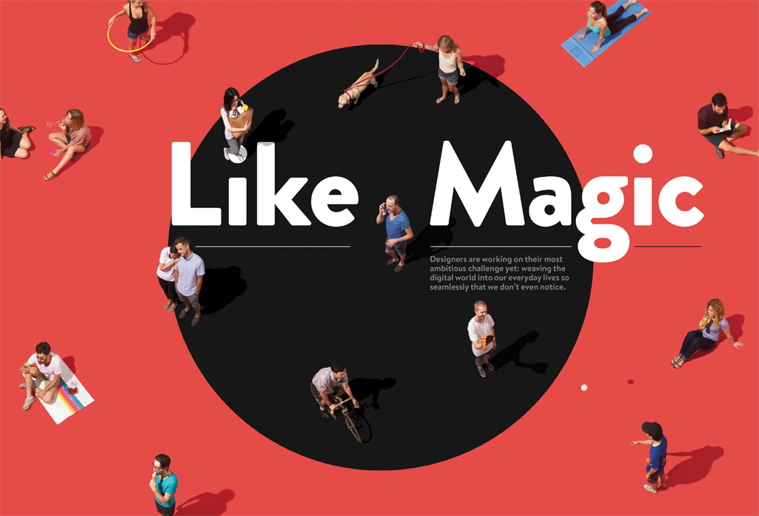
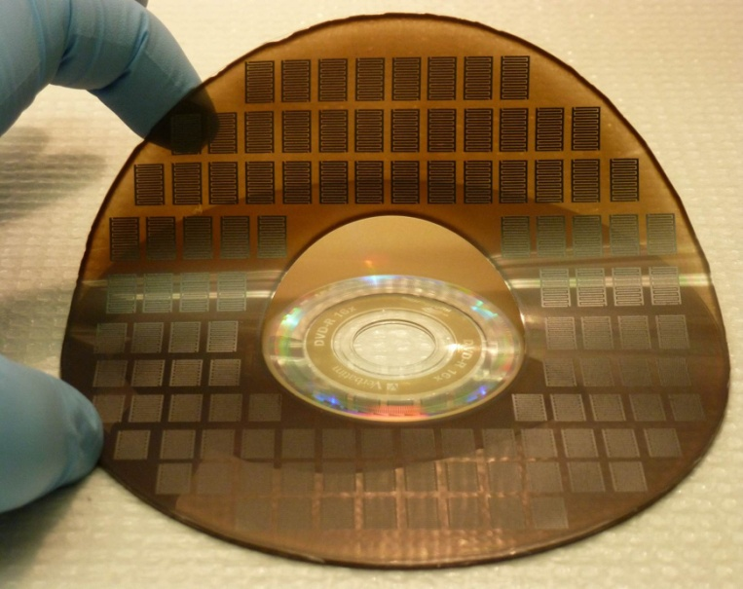
Graphene: What shall we delegate to it?
A needs-based study for experience design
IMOS
Intended for classroom instruction only.
Do not circulate.
Notes:
What does graphene do??
Thermal/heat conduction – no need for cooling – low power consumption
Flexible electronics with faster, smaller chips – flexible touch screens – replace silicon electronics. Reduce weight/size while keeping strength.
Nanomaterials: toxicity, damage to ecosystem, regulation, cross brain-blood boundary
Toxicity – like the whole cell phones give you cancer debate?
Niche applications: cell phones
2. Read Kuang, Cliff (2013) “Why a New Golden Age for UI Design Is Around the Corner”. Wired Magazine, September: 142-147. http://www.wired.com/design/2013/08/design-and-the-digital-world/
In the wrong hands, this is a dystopian prospect—technology’s unwanted intrusion into our every waking moment. But without the proper design, without considering how new products and services fit into people’s day-to-day lives, any new technology can be terrifying. That’s where the challenge comes in. The task of making this new world can’t be left up to engineers and technologists alone—otherwise we will find ourselves overrun with amazing capabilities that people refuse to take advantage of. Designers, who’ve always been adept at watching and responding to our needs, must bring to bear a better understanding of how people actually live. It’s up to them to make this new world feel like something we’ve always wanted and a natural extension of what we already have
Go Through Some Interview Questions
3. Schedule and conduct a 15-minute interview with someone you know (a friend, roommate, relative, co-worker, etc.). The exact interview questions are up to you, but we suggest that you discuss how people feel about the digital technologies that they use in their everyday lives. What are their personal relationships to these materials and artifacts? How do these artifacts mediate their relationships with other people, and how do they use them to develop their own self-identities? Take notes during the interview and bring your interview notes to class (about 1 page, hand-written or typed). You will submit these notes with your in-class group activity. Please do not include any identifying details about the person that you interviewed (e.g., name, address, job location/title).

Slide 27
Extra slides on the digital divide to use as needed
IMOS
Intended for classroom instruction only.
Do not circulate.

Slide 28
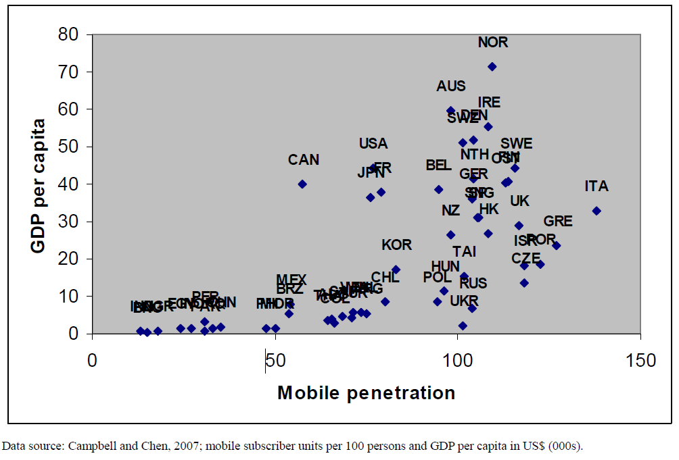
Digital Divide
1. Cost
IMOS
Intended for classroom instruction only.
Do not circulate.

Slide 29
Digital Divide
2. Access
IMOS
Intended for classroom instruction only.
Do not circulate.

Slide 30
Digital Divide
3. Complexity
IMOS
Intended for classroom instruction only.
Do not circulate.

Slide 31
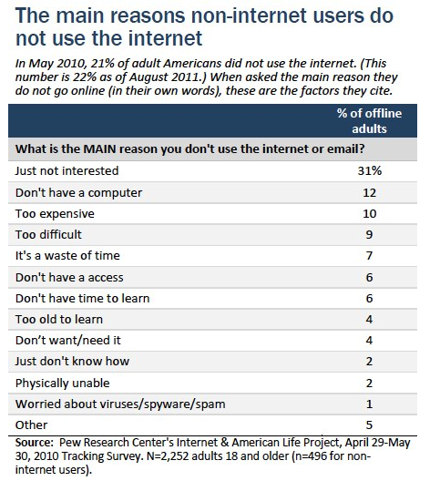
Digital Divide
4. Personality?
The Digital Divide: PewInternet.org
IMOS
Intended for classroom instruction only.
Do not circulate.

Slide 32
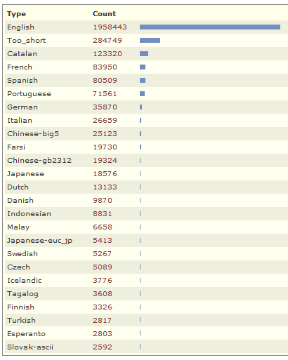
Cultural Divides?
ASCII character set until Unicode (1966)
2012 NITL blog census (National Institute for Technology and Liberal Education) funded by Mellon Foundation
KnowledgeSearch.org
IMOS
Intended for classroom instruction only.
Do not circulate.

Slide 33
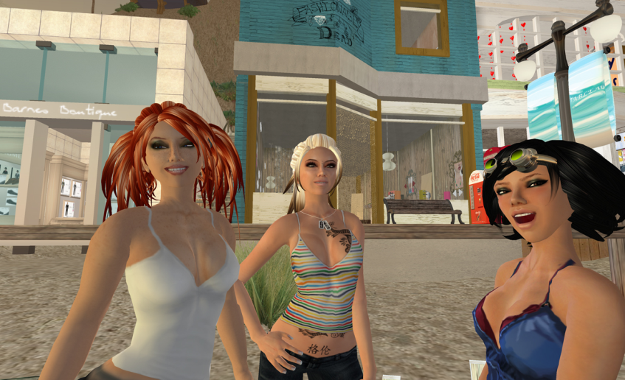
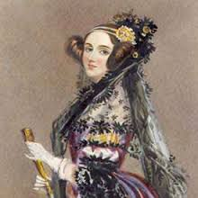
A Gendered Divide?
Women’s IMs are 3x more likely to begin with an opener. (e.g., hey, sup)
Men write to communicate information (what happened); women’s messages more likely to include expressions of support, qualifications, etc.
13% of Wikipedia Editors are Women
October 14 is Ada Lovelace Day!
IMOS
Intended for classroom instruction only.
Do not circulate.
Notes:
You’re asked to select gender when you fill out a profile

